Slide 1


Ain’t Nothin’ but a G Thang
The Evolution of Cellular Networks
Tracy Mosley
hackerpinup
hackerpinup@infosec.exchange
DEFCON 31
Notes:
Welcome to my talk!
Thanks for coming. I’m super excited to be speaking here.
Forgive the throwback title. I am all about having some fun with this and it was all I could think of.
All public information! Now you can know what more you want to look for
Some of you may have seen that I presented a similar talk at Shmoocon. This will be a different focus, with some overlap. So let’s get to it.
I wanted to give this talk because really, cellular technology is unavoidable in our lives. We have modems in our pockets, on our wrists, in our cars!

Slide 2

Who am I?
Vulnerability Researcher at Trenchant
RE and embedded dev
Telco focused
~10 years of experience
Computer Engineering Degree
Notes:
So who am I?
Vulnerability Researcher at Trenchant (formerly known as azimuth security)
Previously split time doing RE and embedded dev
Telco focused
~10 years of experience

Slide 3

What to cover
2G: GSM. Digital Technology! Voice and Data. Circuit Switched.
GPRS: Both Circuit and Packet Switched!
3g: UMTS.
LTE: Evolved packet core!
4G: LTE Advanced. VoLTE, IPv6, IMS.
5G: NR. Virtualization. Network slicing. Functionality generally split into “functions” instead of devices.
Notes:
Just to lay out my plan for this talk so you can follow along we have:
I’ll be covering network architecture, mitigations, and public vulnerabilities or attacks for
2G and GSM
GPRS
3G and UMTS
LTE
4G
5G

Slide 4
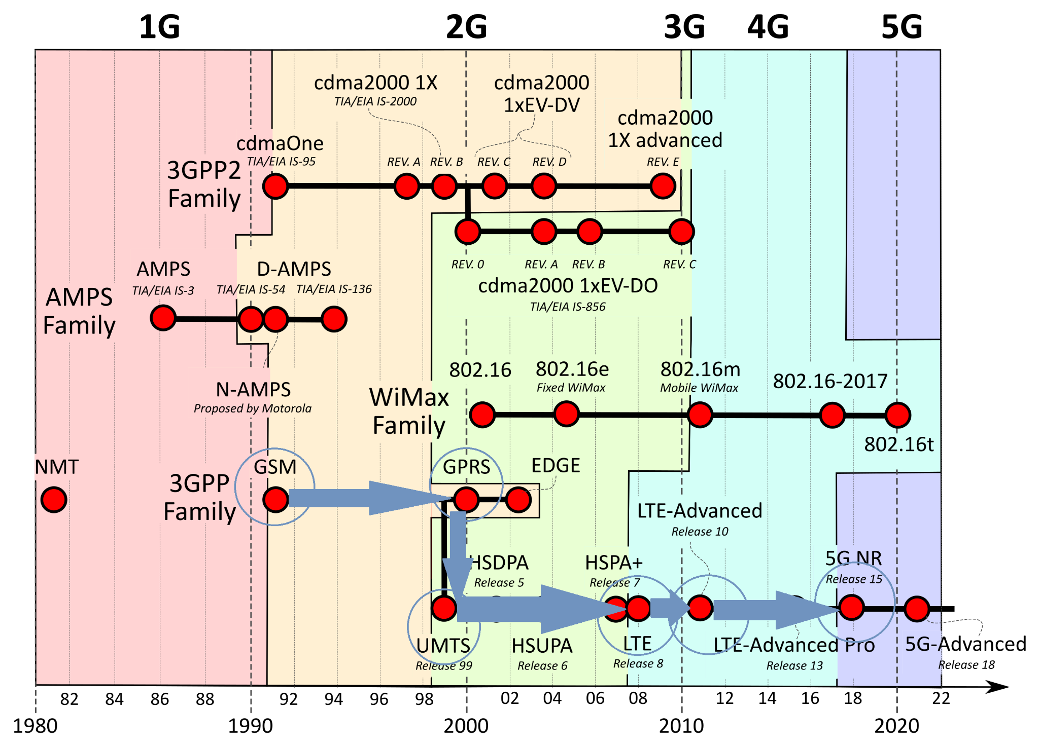
Notes:
Image stolen directly from Wikipedia and it is the most awesome visual of cellular networks.
https://en.wikipedia.org/wiki/Cellular_network#/media/File:Cellular_network_standards_and_generation_timeline.svg
So here’s that path forward again, this time visually.
Now notice how this image is split up into the different generations and has these labels underneath it. While they are all specifications, the terms below are specifics that fit within the defined specifications for that generation.

Slide 5

Basic Cellular Concepts
POTS
Plain Old Telephone Service
PSTN
Public Switched Telephone Network
Circuit Switched
PDN
Public Data Network
RRC
Radio Resource Control
RAB
Radio Access Bearer
Notes:
Here I’ll briefly mention POTS and PTSN because they are often reached at some point by a cellular network and some of the network diagrams will show the term.
POTS Plain Old Telephone Service.
regular old style telephone
connected over the local loop provided by the telecommunications provider.
POTS is a service
PSTN
Public Switched Telephone Network.
landline network made up of copper telephone lines
by circuit-switched, initially analog means.
Sometimes POTS and PSTN are used interchangeably, but really are different
PSTN is the network, POTS is the service.
Circuit Switched initially means v analog
When in the cellular domain, it may help to remember images of old timey telephone switches where connections were literally switched over the wire.
PDN - Public Data Network
Cells
These are geographical regions served by a fixed-location transceiver. The cells don’t move, only the user moves in relation to the ‘cells’
Bearer - This is the same as generally meant in communications systems. A bearer is a carrier of information between one node to another. These can be physical or logical. Oftentimes in telco “bearer” will be used internally to the system to define the network or things within a network and MNO (mobile network operators) are referred to as carriers by the broader world colloquially
RRC: Radio Resource Control. L3 control plane
RAB: Radio Access Bearer. User plane between UE and CN

Slide 6
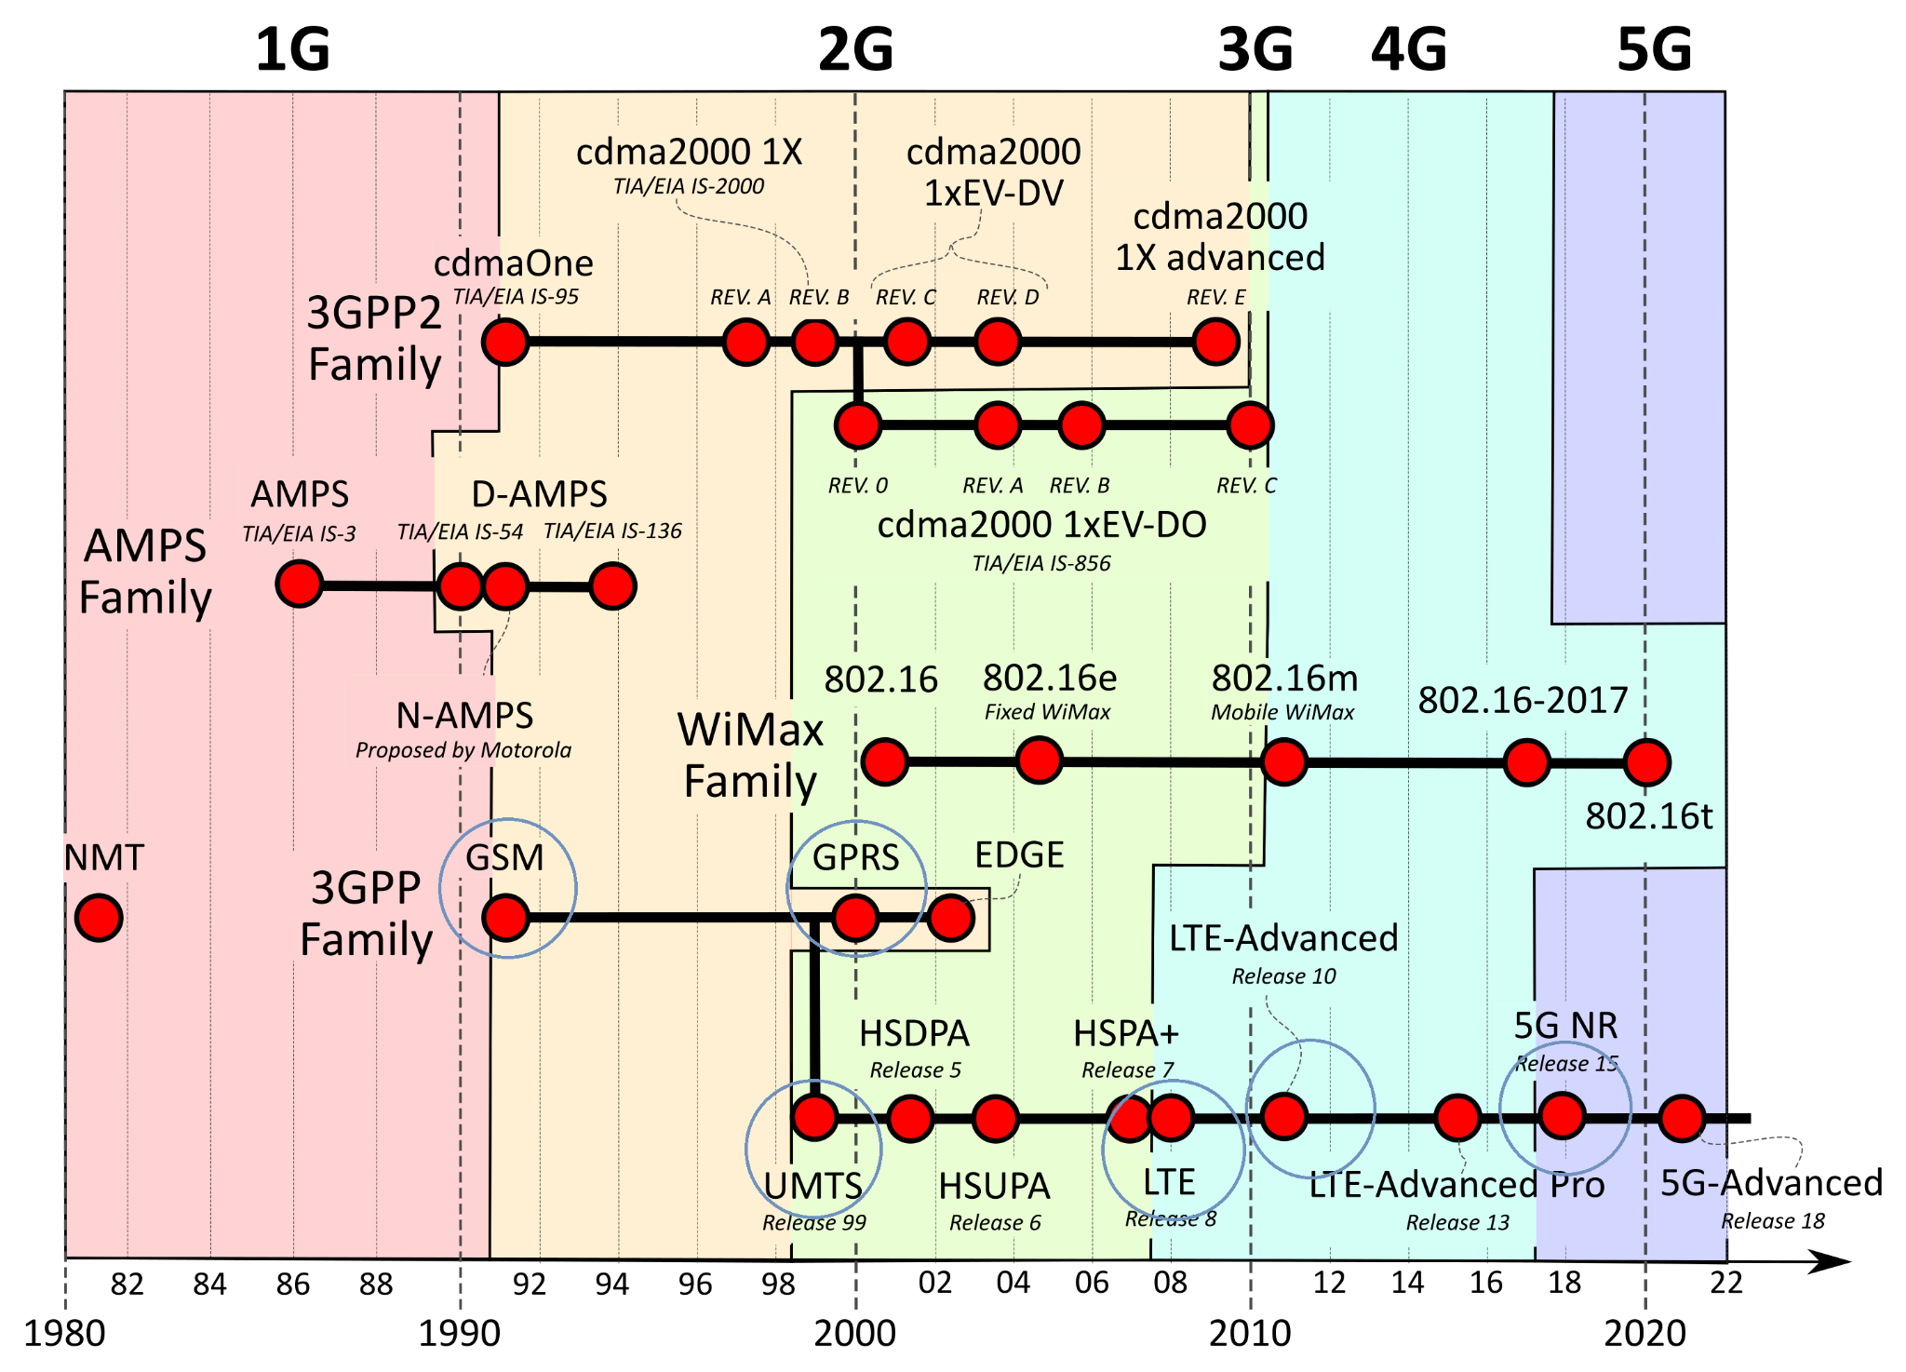
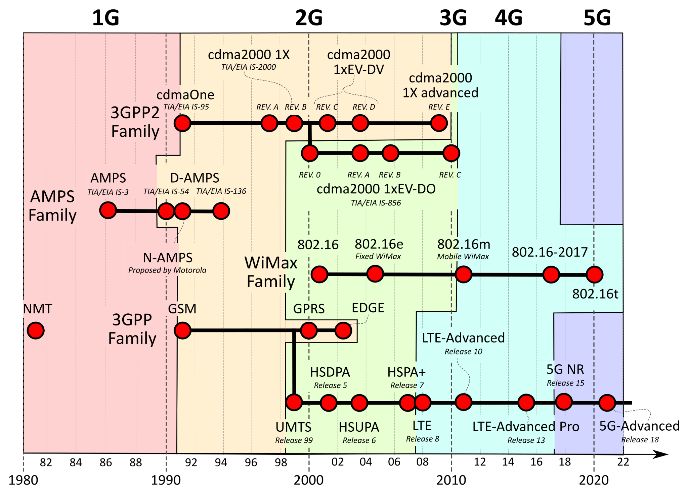
Notes:
So let's jump in!
Fun fact: The 1G family is actually only dubbed 1G AFTER 2G gets defined.
So first thing’s first, 2G implemented via GSM!

Slide 7

2G
Calls
SMS
ETSI and GSM standardizing!
SS7 for signaling
GSM
Notes:
TMobile still uses 2G in the US for fallback support. It’s still supported in much of the world and therefore still very relevant.
And we need to lay out 2g as a basis for future understanding
Texting! No data yet.
ETSI and GSM standardizing!
This 2g era was really taking place throughout most of the 1990s

Slide 8
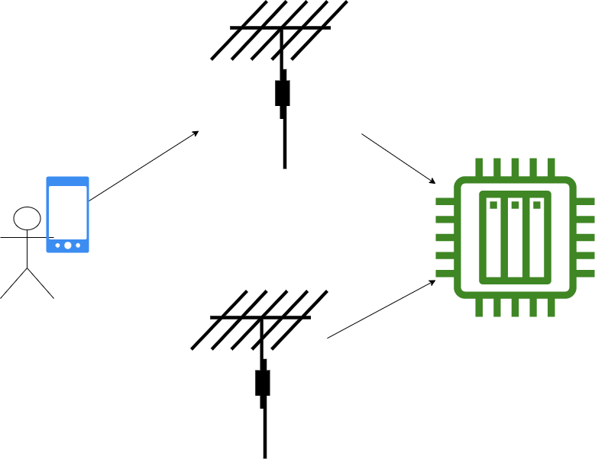
2G - GSM - Network Architecture
Mobile Equipment (ME) or Mobile Station (MS)
This is usually the whole device in your hand when you’re making a call.
Radio Access Network (RAN)
In GSM it is the same as the Base Station Subsystem (BSS)
BSS contains
One or more Base Transceiver Stations (BTS)
Base Station Controller (BSC)
Base Station Subsystem
BTS
Radio Access Network
BSC
BTS
MS
Notes:
ME/MS - Mobile Station
device you use to speak into.
any mobile unit with cellular functionality in 2g.
This is what goes around with you.
RAN - Radio Access Network
this is the part a lot of people think as the cellular network.
antennas and radios and BBUs (baseband units).
In GSM it is the same as the BSS which is the Base Station Subsystem
The BSS contains
Base Transceiver stations and the
Base Station Controller.
BSC essentially controls several BTS
and communicates through to the Core Network functionality.

Slide 9
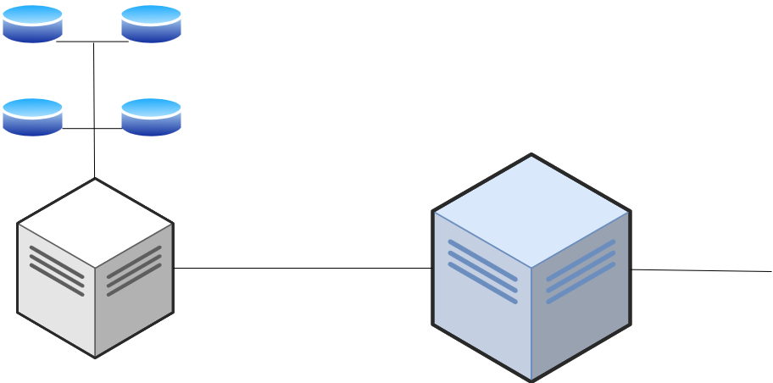
2G - GSM - Network Architecture
Mobile Switching Center (MSC)
Handles the call switching, handover, registration, authentication.
Home Location Register (HLR)
Large DB of user information for “local” users
Visitor Location Register (VLR)
Large DB of user info for visiting users
HLR
VLR
Authentication Center (AuC)
Secret keys stored here
EIR
AuC
Equipment Identity Register (EIR)
Large DB of valid equipment on the network.
Gateway Mobile Switching Center (GMSC)
MSC
GMSC
Notes:
Reiterate the front end of GSM
The BSC then has to communicate with the remainder of the network.
And what does that look like? Well this is usually called the Core Network.
MSC - Mobile Switching Center.
handles most of the functionality.
contains a bunch of other acronyms.
These acronyms are kinda just for acronym’s sake and are really unnecessary names. I’ll detail them regardless.
HLR - Home Location Register
Large db for info on “local” users.
info about activity, status, location, etc for non roaming users.
VLR - Visitor Location Register
It’s temporary information db
visiting users.
AuC - Authentication Center
Secret keys for SIM (PUK and PIN) are stored here for authentication
EIR - Equipment Identity Register
DB of valid equipment on the network.
only valid IMEIs/MSISDNs are allowed to access this network.
When a device goes from one MSC’s territory to another the VLR will reach out to the HLR and store info about that Mobile Station. There’s a lot of communication necessary between visitor register and home register since this is a mobile technology.
GMSC - Global/Gateway Mobile Switching Center and interfaces to external networks!

Slide 10
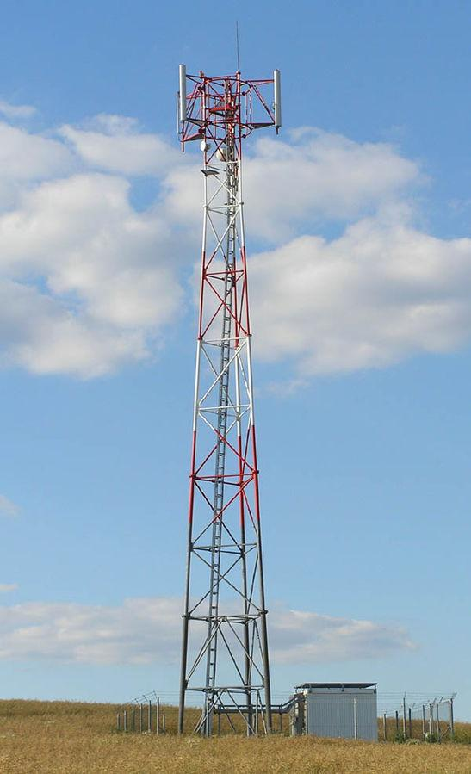
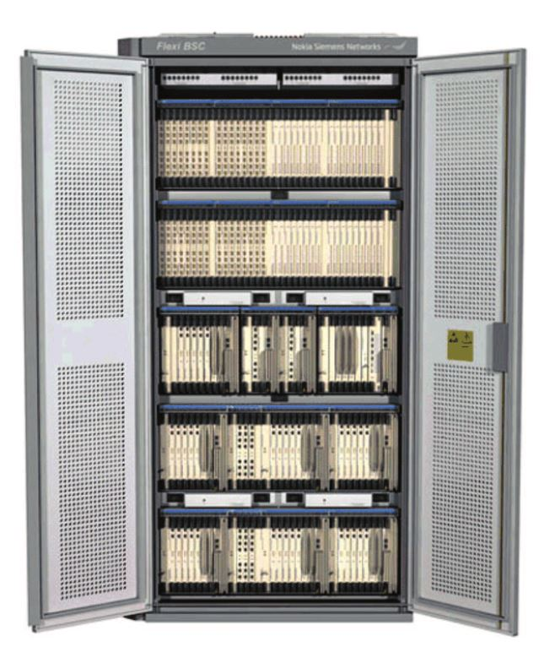
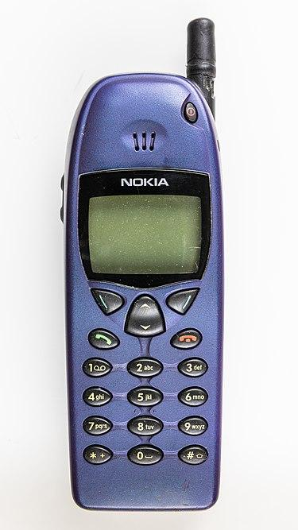
Notes:
Obviously not to scale, but just to show you a representation of the technologies we’re talking about here.
old style Nokia cell phone,
a cellular base transceiver station with antenna and follow on processors,
Base Station Controller
(here by Nokia Seimens Networks)

Slide 11
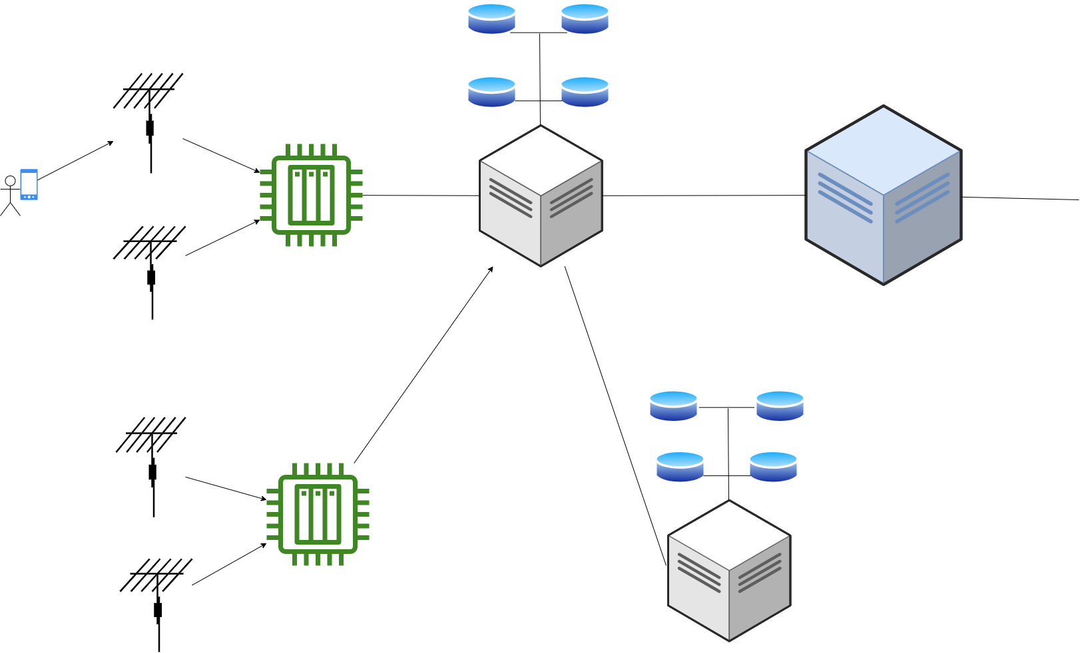
2G - GSM
HLR
VLR
BTS
BSS
EIR
AuC
BSC
GMSC
MSC
BTS
Mobile
Station
HLR
VLR
BTS
BSC
EIR
AuC
BTS
MSC
RAN
Core Network
Notes:
User speaks into their 2g capable device and comprises the Mobile Station.
Mobile Station sends signal to the Base Transceiver Station which is then properly handled by the Base Station Controller.
The BSC continues coordination with the Mobile Switching Center (MSC) which utilizes the appropriate registers and authentication to then pass it on to the GMSC
The GMSC reaches out to external networks! (PSTN, PLMN)
Here we see one more time the Radio access network and the core network

Slide 12
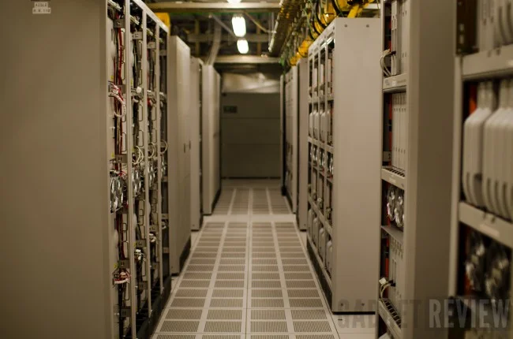
Notes:
And just for reference, this is an MSC.
size and scale of the devices

Slide 13

2G - GSM - Attack Vectors
No mutual Authentication
IMSI-catchers / Stingray attacks
Rogue BTS
BTS determines encryption scheme!
A5/1 is easily broken. A5/2 slightly harder but still weak.
Jamming
Network based attacks based on outbound signaling protocol
Clear text tx after BTS
Notes:
GSM doesn’t require mutual authentication
IMSI catchers or stingray attacks.
GSM requires the handset to authenticate with the network, but not vice versa.
The ME/MS (Mobile Subscriber) beacons to the nearest BTS (Base Transceiver Station) regularly and reveals its IMSI
attacker can pose as the nearest BTS.
BTS determines the encryption mode, which can be set to none(A5/0). Using this an attacker can:
See phone’s IMSI. Glean country code and network carrier.
See phone’s location.
Attacker can:
Location Update Request to the actual BTS the network requests an Identity and the attacker can supply the observed ME’s IMSI.
the Network BTS requests a crypto key to authenticate, the rogue BTS requests the key from the ME which passes it back, and the rogue BTS can forward it to the NETWORK BTS.
Thus, it can maintain a connection to both the handset and the real base station and execute a full person-in-the-middle attack.
DoS - easy it doesn’t even need to connect to the actual network
Can intercept outgoing calls or SMS and not necessarily forward them to the actual network. (black hole attack)
Impersonation: call and sms spoofing
Re order or replay signals.
A5/1 is an easily broken crypto scheme. Like super easy. A5/2 is slightly harder but also known to be weak.
Jamming: disrupting comms between cell and the BTS
Signal generator at specific frequencies for interference. This can happen at the UE or BTS.
SS7 attacks:
SS7 was originally developed for PSTN
Lots of research since on this including many defcon talks and white papers. So I won’t go deep on this…
Pretty much this Common Channel signaling was used for many signaling purposes but most notably the ability to roam.There is assumed trust in this signaling protocols,
One significant report was in 2014
Ukrainian mobile subscribers were affected by crafted SS7 packets from Russian telco equipment.
Because of these ss7 packets, it’s believed, that a leaked conversation between US ambassador to Ukraine and US Assistant Secretary of State was intercepted in Ukraine this way.
Clear text transmission after the base transceiver station

Slide 14
Notes:
On to GPRS which you’ll notice doesn’t quite fit neatly into this timeline. What is GPRS?

Slide 15

2.5G
Packet Switched + Circuit Switched
GSM + IP
More Services!
MMS
Push-To-Talk over cellular
4+1 or 3+2 timeslots
GPRS
Notes:
The wonderful world of IP
General Packet Switched Radio
So GSM is only a circuit switched technology. The path between communication is unbroken.
It’s neat because we now have two technologies in one network architecture.
This means it’s GSM + a packet switched IP implementation.
Now we’re able to implement sms and mms, push to talk over cellular

Slide 16
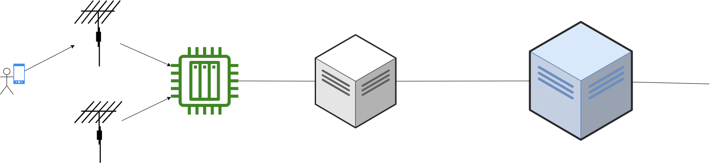
2.5G/GPRS - Network Architecture
Front part mostly the same
Mobile Station (MS) / User Endpoint (UE)
Same thing. Now we also consider the Mobile Equipment (ME).
BSS remains the same
BTS and BSC still there
Circuit Switched Mobile GateWay (CS-MGW)
Hands it off to the known MSC.
MSC functionality of before is needed for both portions of the network
Still feeds into the GMSC
BTS
MSC
BSC
GMSC
MS
Notes:
Front part mostly the same
Mobile Station (MS) / User Endpoint (UE)
Same thing. Now we also consider the Mobile Equipment (ME).
Base Station Subsystem remains the same
Base Transceiver Station and Base Station Controller still there
Mobile Switching Center (MSC) functionality of before is needed for both portions of the network
Still feeds into the Gateway MSC
So this all looks the same so far and it is for the packet switched portion.
But remember that GPRS is split into the circuit switched portion and the packet switched portion.
All those registers available for both the circuit switched AND packet switched portion

Slide 17
2.5G/GPRS - Network Architecture
GPRS Support Nodes
Serving GPRS Support Node (SGSN)
location, sec and access controls, mobility management and charging
communicates with other SGSN or MME (mobility management Entities) in same network and/or reaches out to the GGSN.
GPRS Gateway Support Note (GGSN)
a router in the subnetwork.
Converts incoming IP traffic into GSM and hands that off to the SGSN.
Border Gateway and/or Charging Gateway
GGSN often contains this functionality
Notes:
shiny packet switched features!
packet switched portion as the internet-y portion.
So the whole front end of the Mobile Station, Base Transceiver Station and Base Station Controller stay the same
packet switched portion of the core network, the BSC feeds into
Serving GPRS Support Node (SGSN)-
location, sec and access controls.
packet routing and transfer
MM (mobility management),
authentication
handles (GPRS Tunneling Protocol) GTP packets,
communicates with other SGSN or MME (mobility management Entities) in same network and reaches out to the GGSN.
GPRS Gateway Support Note (GGSN)
last hop to Public Data Network (PDN)!
assigns IP addresses for the devices internal to this part of the cellular network.
gateway, router and firewall all in 1. Usually viewed as a router.

Slide 18
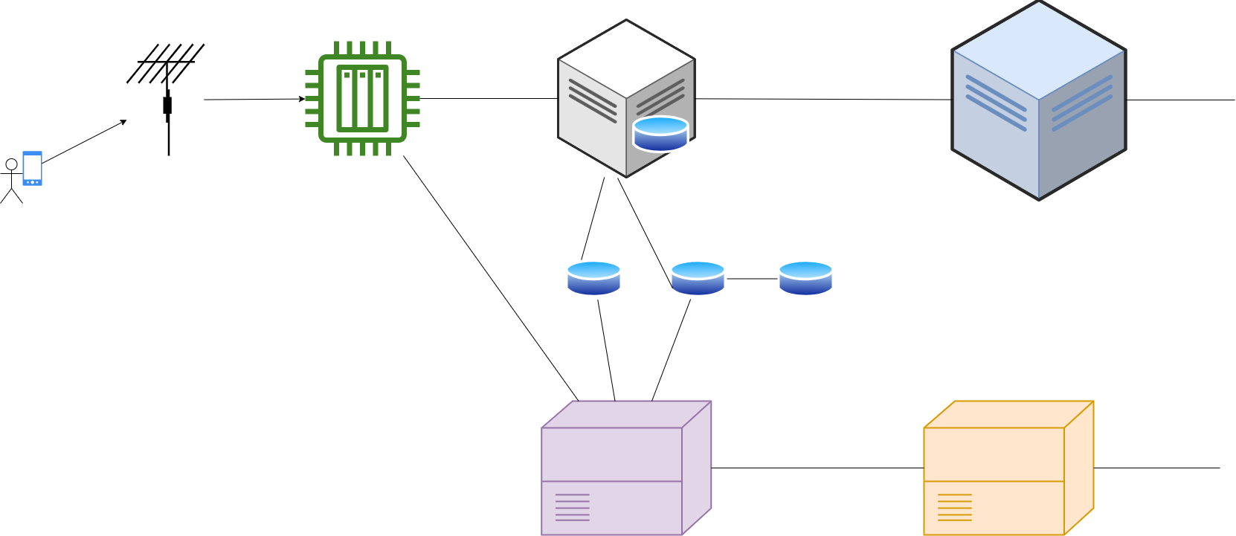
2.5G/GPRS
Circuit Switched
BTS
BSC
MSC
GMSC
MS
VLR
HLR
EIR
AuC
SGSN
GGSN
Packet Switched
Core Network
Notes:
So let's look at what this network architecture looks like all together
Here we see the portions that stayed the same but now that we add the packet switched area which contains this SGSN and GGSN

Slide 19
Mitigations from 2G
Mutual Authentication for Packet Switched Portion
Authentication between MS and SGSN
Some level of Ciphering algorithm for SGSN.
PDU still transmitted in plain text.
SGSN identity verification.
Notes:
New Mitigations:
– Required mobile subscriber authentication by network for packet-switched portion
Previously the subscriber authenticated the network only
Added Certificate-based authentication.
– auth between MS and SGSN
– Some level of Ciphering algorithm for SGSN.
– SGSN requests identity verification.

Slide 20

2.5G/GPRS Attack Vectors
Same known rogue BTS flaws
Some implementations without any encryption
Italy and Denmark according to P1
Nokia GGSN attack
non-standard IP options in a packet over the Gi interface
GTP weaknesses
GPRS Tunnelling Protocol has no encryption for User Plane or Control Plane.
Infra attacks, overbilling, protocol anomaly attacks
Cisco GGSN ASR 5000
Improper Wireless Session Protocol (WSP) packet handling
Portal Page bypass
Improper HTTP packet handling
Send requests through GGSN without Verifying!
Notes:
Same known rogue BTS flaws
P1 really neat telco research
They found implementations of GPRS without any encryption
Italy and Denmark p1
Nokia GGSN was able to be taken down and/or restarted disrupting GPRS network connectivity for a whole area of users.
sending non-standard IP options in a packet.
This was done over the Gi interface
GTP weakness -
GPRS has a User plan (GTP-U) and Control Plane (GTP-C) and charging (GTP’).
GTPC is commands like creating and attaching PDP contexts
GTP has no encryption abilities.
both the signaling plane AND the user plane GTP packets are sent in the clear.
A compromised GPRS backbone network (most notably SGSN and GGSN) will allow the attacker to monitor and manipulate GTP traffic since it is sent in the clear.
Infra attacks, overbilling and underbilling (free to use!), protocol anomaly attacks
Cisco gateway GPRS support node (GGSN) of Cisco ASR 5000 Series Aggregation Services Routers
doesn’t handle Wireless Session Protocol (WSP) packets correctly
Carefully crafted WSP packets allow attacker to bypass a portal page and allow them to use this carrier for free.
Doesn’t sufficiently validate HTTP traffic w one or more packets with additional bytes at end of packet.
Modify payload of HTTP traffic and can send requests through GGSN without verifying!

Slide 21

3G
More internet functionality!
Video Chat!
Mobile Broadband!
SIGTRAN
UMTS
Notes:
Moving on to 3G there's much more internet functionality.
Video Chat
New Signaling methods

Slide 22
Notes:
So now moving on to 3g in the form of UMTS
See how it fits weirdly in the timeline with GPRS above it

Slide 23
3G - UMTS -Network Architecture
Kept most of GPRS
RAN is now called UTRAN (UMTS terrestrial Radio Access Network)
NodeB
This is literally the same basic placement in the network and functionality as the
Radio Network Controller (RNC)
In charge of all NodeBs for radio management.
Some Mobility Management
User data encryption
Notes:
most of the network diagram can stay the same. But new terms!
still have registers, MSCs, AuC, and the GPRS support nodes.
Still need the base station subsystem.
MS -> User Endpoint/User Equipment (UE)
RAN - Radio Access Network.
UTRAN (UMTS terrestrial RAN)
aka Radio Network Subsystem (RNS)
Node B is a new term for the base transceiver station.
RNC! - Radio Network Controller
charge of all the Node Bs connected to it
handles radio mgmt
some mobility mgmt
adds encryption to user data
A loooot like that Base Station Controller from before
But the MSC stays, it used to be just for circuit switched operations and now it kind of just determines the MGW operations.

Slide 24
3G - UMTS - Architecture
MSC
GMSC
MS
UE
VLR
NodeB
RNC
HLR
EIR
AuC
SGSN
GGSN
Notes:
Here is the network diagram again, with our BTS turning into our NodeB
The BSC device is now the RNC.
The core network stays the same from GPRS to 3g!

Slide 25

Mitigations from 2.5G
(Attempts at) IMSI catcher mitigation
Radio Access Link preserves IMSI confidentiality
User Location confidentiality
Signaling plane and user plane now have confidentiality requirements in the specs!
Security should now be shown to the user
eg when hand off occurs to 2G
True Mutual Auth!?
Notes:
Mitigations
– True mutual auth!
Attempts at IMSI catcher mitigation -
The literal guidance is to not keep the same temporary identifier for long periods of time.
– Radio Access Link preserves IMSI confidentiality
– Attempts to preserve confidentiality of User Location when added to certain cells over the Radio Access Link.
– Signaling plane and user plane now have confidentiality requirements in the specs!
– The visibility of security should now be shown to the user (eg when hand off occurs to 2g)

Slide 26

3G - UMTS - Attack Vectors
Rogue NodeB (BTS) can still happen
Remote IMSI Attack
Integrity keys between UE and RNC are generated in the Core Network and tx unencrypted to RNC, and sometimes between RNCs
Integrity of user data is not defined
Signaling Plane RAB
Mobile Network Operators receiving UE capabilities plain-text
HLR overloading using SQN
Cisco ASR 5000 Series GGSN
Not properly handling TCP packets
Notes:
Rogue BTS can still happen (Node B now tho!), but since it’s not very targeted its not as popular.
Remote IMSI attack -
Integrity keys used between UE and RNC are generated in the CN and transmitted unencrypted to RNC and sometimes between RNCs unencrypted.
Integrity of user data is not defined
Short time during signaling, signaling in unprotected and can be tampered with
RRC messages, which is the radio resource control, handles the control plane L3 btw UE and core network.
Most messages are integrity protected,
Not protected :RRC connection req, setup, reject and release.
Modifying these messages could result in a connection status change without the User being aware.
Signaling Plane Attacks on RAB - Radio Access Bearer.
There is a lot of signaling overhead for the RNC because Radio Access Bearers are spun up and torn down frequently.
UMTS data call has 12 RAB signals at minimum.
An attacker can overload the RNC by triggering tons of signaling messages.
Essentially, sending bursts at specific intervals causes the RAB to tear down due to inactivity, then a new RAB establishment.
Legit can just be TCP/IP packets sent from a computer.
So RNC and NodeB get congested with setup/release pairs with each RAB, AND the RNC get super busy keeping state and processing all of these signals.
Mobile Network Operators (MNOs) request the radio access capabilities from UE prior to RRC security set up. UE capabilities are transferred in plain-text so an adversary can hijack them. (essentially lie about the radio capabilities of the phone which can easily lead to a downgrade attack)
HLR overloading - The SQN (Sequence) value for resynchronizing happens between the UE (previously MS) and the HLR,
remember that to get to the HLR requires going through the SGSN (and/or GGSN).
Repeat msg; tie up the SGSN.
A variant
obtaining a list of IMSIs for a particular mno (carrier.)
attacker generates rrcConnectionRequest messages for each IMSI on the list for a specific mobile carrier.
For each request, the HLR will compute for AVs ( authentication vectors) and send them back to the VLR and such
the HLR gets spammed with lists and folks attempting to connect to that carrier’s equipment legitimately can’t do so.
Cisco ASR 5000 Series GGSN
Not properly handling TCP packets
allow user to reboot Session Management on the GGSN causing a denial of service for all communications with that GGSN

Slide 27
Notes:
The late aughts and it’s time for Long Term Evolution.

Slide 28

LTE
3.95G? 4G? Guess it’s called 4G now?
Core network is now Evolved Packet Core aka System Architecture Evolution
VoLTE, carrier adopted improvements
Diameter
Notes:
“3.95G” and marketed as 4G
this focus is FULLY IP based
initially LTE didn’t fit the Rel 8 and 9 specs for 4g.
later ITU was like “hmm ok it can be called 4g”. That’s why sometimes it’s called “4g LTE” or real 4g is called “4g Advanced” and such nonsense.
Evolved packet core aka System Architecture Evolution
VoLTE

Slide 29
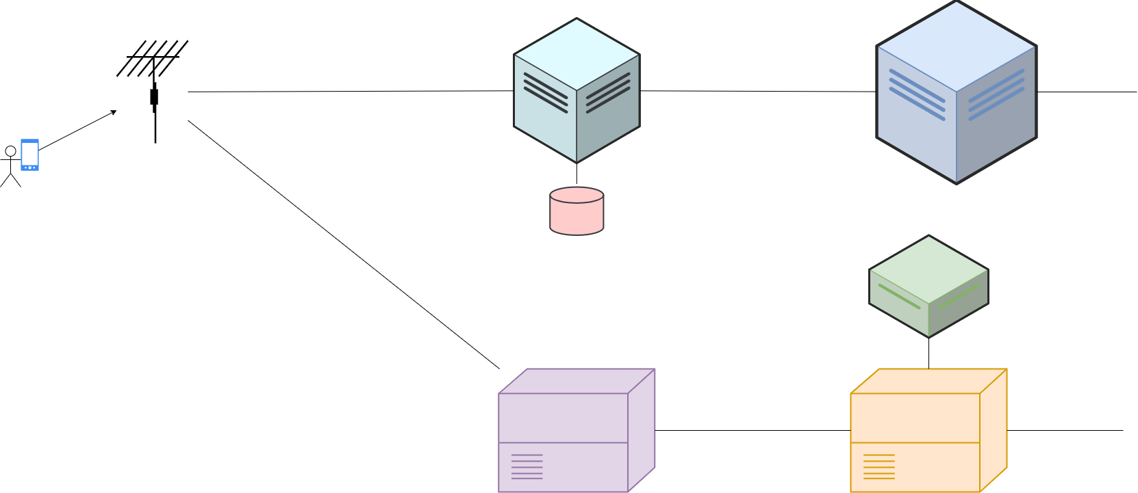
LTE - Network Architecture
eNodeB
Mobility Management Entity (MME)
replaces the RNC
Directs to appropriate SGW.
Home Subscriber Server (HSS)
HLR and AuC combined
eNodeB
MME
HSS
Signal Gateway (SGW)
Routes and Forwards packets.
PDN Gateway (PGW)
policy enforcement, packet filtering, charging
Gateway to the outside
PCRF
SGW
PGW
Policy and Charging Rules Function (PCRF)
Notes:
UE
eNodeB - the NodeB gets an update and gets called the eNodeB
MME - Mobility Management Entity-
replaces the RNC.
bearer activation/deactivation, paging and authentication of UE.
Directs to appropriate SGW. It does the session management and the mobility management
HSS - Home Subscriber Server - HLR and AuC combined and renamed.
S-GW - Signal Gateway
looks a lot like the SGSN.
Routes and Forwards data packets.
P-GW - PDN Gateway, Public Data Network Gateway
Looks like a lot like the GGSN.
It’s the exit for outgoing and entry into the cellular network from the outside.
policy enforcement, LI, packet filtering, charging support etc
PCRF - Policy and Charging Rules Function

Slide 30

Mitigations
eNodeB security?!
IMEI is not sent to eNodeB until NAS (non-access stratum) security established
EEA0
Null X algorithm (Null ciphering algorithm, Null integrity protection algorithm
Mobility Management is now split apart and in its own entity for MME
Notes:
Mitigations:
– eNodeB security?!
- Configuration must be authenticated and authorized to radio access elements.
– IMEI is not sent to eNodeB until NAS (non-access stratum) security established
– EEA0 - Null X algorithm (Null ciphering algorithm, Null integrity protection algorithm
-Mobility Management is now split apart and in its own entity for MME

Slide 31

LTE - Attack Vectors
LTEinspector
LTEInspector: A Systematic Approach for Adversarial Testing of 4G LTE by Hussain, Chowdhurry, Mehnaz and Bertino paper on these attacks.
Authentication Relay Attacks
Paging Channel Hijacking Attack
Panic Attack
Bidding Down Attacks
Capabilities downgraded in quality.
Service can be downgraded to 3g or 2g
Actual Implementation Errors for Identifiers
Cisco PGW 2200 Remote DOS
Notes:
LTEinspector
LTE specifically instead of 4g, thought I believe it applies to 4g LTE and forward, but since the name indicates LTE…
Authentication relay attacks:
impersonate victim cellular device and reach core network without possessing any legit creds.
Can obtain location info and mount DoS attack.
hijack a device’s paging channel
This requires our all-time-fav the malicious eNodeB.
Malicious eNB utilizes the same freq as legitimate eNB.
Malicious eNB broadcasts fake/empty paging messages.
Must be done at same paging cycle as victim UE.
Must be done at high signal strength.
UE only responds to first rx msg which prevents victim UE from receiving valid MME paging msgs.
stop notifications of calls and sms etc, and inject fabricated messages.
Panic Attack:
Inject fake paging messages to arbitrary neighboring UEs.
malicious eNodeB broadcasts paging msgs at all possible paging occasions.
eNodeB then broadcasts warning messages and the UE looks for those.
Bidding Down Attacks
Along with permanent identifiers (IMSI, IMEI), there are temporary identifiers for subscribers within the network. In LTE one of these identifiers is referred to as GUTI (Globally Unique Temporary Identifier).
Due to implementation errors,
the GUTI may become permanent by not actually reallocating appropriately
the reallocation algo of identifiers is figure-outable leading to other identifier leakage.
Some observations were spoken about at Network and Distributed Systems Security Symposium in 2018
Actual carrier GUTI implementations:
Assigning the same GUTI
Reusing GUTI every X calls
Incrementing per calls
Fixed bytes for portions of TMSI or other patterns.
Cisco PGW 2200 Software Switch Multiple Security Vulnerabilities
Issue processing malformed header info (SIP, Contact, General)
Problem parsing “overlong” messages
Problem processing SIP test requests
Problem handling session attribs
SIP packets in general!
Problem w MGCP packets
Can Deny Service using these means, the PGW
won’t establish new TCP connections and will stop receiving TCP connections.
No new SIP connections, though current call won’t drop
Fail to connect to SSH, HTTP, telnet etc

Slide 32
Notes:
Moving into the 20teens and it’s finally time for 4G! And by that I mean “real” 4G

Slide 33

4G
IPv6 expansions
Adaptive modulation
Time varying channel
Voice over LTE
Carrier Aggregation (LTE Advanced) and enhanced carrier aggregation (LTE Advanced Pro)
IP Multimedia Subsystem
LTE Advanced, LTE Advanced Pro
Notes:
4G as “LTE Advanced” and “LTE Advanced PRo”
IPv6 expansions
adaptive modulation
time varying channel
Voice over LTE.
Carrier Aggregation (LTE Advanced) and enhanced carrier aggregation (LTE Advanced Pro)
IP Multimedia Subsystem

Slide 34
4G - LTE Adv - Network Architecture
Same as 3.95G
UE
eNodeB
MME
HSS
SGW
PGW
PCRF
eNodeB
MME
HSS
UE
PCRF
SGW
PGW
Notes:
Same general arch of LTE of
UE,
eNodeB (BTS),
MME,
Home Subscriber Server,
Signaling GW,
PDN GW,
Policy and charging rules function

Slide 35

Mitigations from LTE and Prior
All radio interface data shall be encrypted
AKA procedure for mutual auth between UE and EPC
Different session keys for encryption and integrity protection
CU-DU to make up eNodeB possible
MNO may provide confidentiality in Radio Resource Control (RRC) signaling.
Secondary authentication (for data network outside MNO)
Notes:
Mitigations
– All radio interface data shall be encrypted
– AKA procedure for mutual auth between UE and EPC
– Different session keys for encryption and integrity protection
– CU-DU to make up eNodeB possible
– MNO may provide confidentiality in Radio Resource Control signaling.
– Secondary authentication (for data network outside MNO)

Slide 36

4G - LTE Adv - Attack Vectors
Still have IMSI catchers!
Signaling vulns of Diameter
VoIP SPIT Flooding
Syn flooding
UDP flooding
P2P/M2M attacks
Router Vulns
Notes:
SS7->Diameter signaling
VoIP SPIT flooding (Spam over internet telephony) - a bunch of types such as syn flooding, udp flooding
P2P/M2M attacks
Router Vulns found:
ZTE Info Leak and ACE,
Takeshi found cmd injection vuln in MF910 and MF65+ products.
Params are not properly checked and can run arbitrary cmds
Auth bypass in MF910 device auth info pre-auth.
Cross-Site Scripting point in a totally unused “test” page.
Hidden code talk by pentestpartners @ DC27
TPlink pre and post auth cmd exec,
Netgear firmware encryption errors

Slide 37
4G - LTE Adv - Attack Vectors
Cisco ASR 5000 PGW DoS
MME vuln
P1 HITB talk on keys being hardcoded
MML Interface exposed to the wide internet on some routers
Bidding down attacks
VoLTE can be denied
Notes:
Cisco PDN Gateway (PGW) ASR 5000. -
preauth, remote attacker can stop ICMP traffic cuz of Vector Packet Processor
Vector Packet Processor improperly handles malformed packets
ICMP over IPsec can be denied by sending a malformed Encapsulating SEcurity Payload packet
GTP packet header improperly validated.
Sending a crafted GTP packet to the Cisco PGW to target the Session Manager.
Session Manager restarted unexpectedly.
MME vuln: P1 (highly rec) gave a talk (hitb) and noted that the MME keys are hard coded
MML interface: P1 again just showed that some of the MML interfaces are just open to the wide internet on a pgw
VoLTE can be denied now in a bidding down attack

Slide 38

5G
Network Function Virtualization
Management and Orchestration is now officially part of the core network
New concept of Network Slicing
Different devices have different needs!
Renaming the eNodeB to gNodeB just cuz!
Not just for telephony!
Notes:
network Function Virtualization
running on COTS servers.
M&O (management and orchestration)
now officially part of the core network.
Since most elements are virtualized and sending API calls, we need a driver of some kind.
New concept of Network Slicing: Creating logical networks over the same physical infra. So like we can have different QoS and such for 5g for different types of devices. IT’s all about converging technologies so it’s like how smart meters versus a voice call have different network requirements and expectations.
eNodeB -> gNodeB

Slide 39
Notes:
it’s like now.
And yes, this is the last one I’m going to cover, but it’s also where everything changes, cuz everything does.

Slide 40
5G - NR - Network Architecture
Access and Mobility Management Function (AMF)
Session Management Function (SMF)
PDU management, pcf interaction for data network profile
UPF selection, IP address allocation if IP based
User Plane Function (UPF)
Also would have been in MME
Anchor for NG-RAN mobility and QoS flow, Policy enforcement
Unified Data Management (UDM)
Access authorization, Data network profiles
Registration and Mobility Management
Policy Control Function (PCF)
Dynamic policy decisions and conditions.
Notes:
Lots of new acronyms
5g doesn’t necessarily require all IP based like LTE did.
eNodeB-> gNodeB
Access and Mobility Management Function (AMF) - similar to MME.
Mobility Management (subscriber mobility and reg and sec)
SMF - Session Management Function -
PDU management,
pcf interaction for data network profile,
upf selection and ip addr alloc.
Choose the UPF and allocates IPv4 or IPv6 if they’re IP based.
UPF - User Plane Function -
Also would’ve been part of the MME.
Anchor point for NGRAN mobility and qos flow and policy enforcement.
UDM - Unified Data Management -
access authorization ,
reg/mobility management
data network profiles.
tells AMF and SMF what the user can do or access or QoS or etc
PCF - Policy Control Function -
Dynamic Policy Decision and Conditions as well as the Ability to alter mobility and session service aspects.
Are there any current network conditions that’ll affect the user?

Slide 41
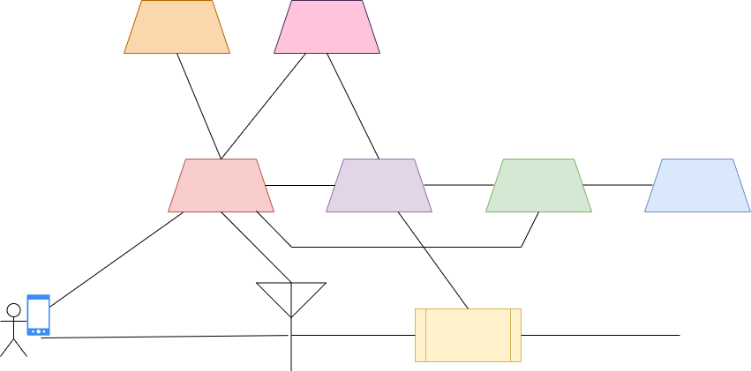
5G - NR
AUSF
UDM
App
Func
AMF
SMF
PCF
UE
UPF
gNodeB
(R)AN
Notes:
See how the User Endpoint and the Radio Access Network look very much like before.
So we have our user endpoint,
Our gNodeB (which makes up our Access Network)
And Those new elements are
UPF - User Plane Function at the end of that row - mobility and qos flow and policy enforcement.
Access and Mobility Management Function (AMF) - subscriber mobility and reg and sec
SMF - Session Management
PCF - Policy Control Function
UDM - Unified Data Management - It tells AMF and SMF what the user can do or access or QoS or etc
PDN becomes just DN

Slide 42
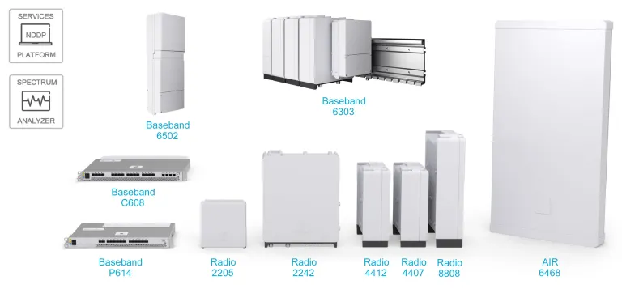
5G - NR
Notes:
Do you all remember the gigantic devices 2G had?
And most generations kept large chassis.
But now, even though there’s a lot more functions in 5G, it looks like this. Much smaller.

Slide 43
Mitigations from 4G
Initial NAS message confidentiality!
Subscription Concealed Identifier (SUCI) and Subscription Permanent Identifier (SUPI) to protect IMSI
Security and Mobility separated in the core network
256bit keys supported
(“prepared to” in 4G docs, now “must”)
Mutual auth between Network Exposure Function (NEF) and Application Function (AF)
Inter-PLMN UP Security (IPUPS) in UPF at perimeter to protect user plane messages (GTP-U).
AUSF and UE now have SoR counter to mitigate replay attacks.
Security Anchor Function (SEAF) allows AKA to skip full reauth
Notes:
Mitigations
– Initial NAS message confidentiality!
Before we had IMSIs. Now we have SUCI and SUPI
SUPI - Subscription Permanent Identifier- 15 decimal string
SUCI - Subscription Concealed Identifier (SUCI)
These came about to try to defeat IMSI catchers by not simply using an IMSI.
Security and Mobility separated in the core network
256bit keys supported (“prepared to” in 4g docs, now “must”)
Mutual auth between Network Exposure Function and Application Function
Inter-PLMN UP Security (IPUPS) in UPF at perimeter to protect user plane messages (GTP-U).
AUSF and UE now have SoR counter to mitigate replay attacks.
Security Anchor Function (SEAF)
Isn’t in my diagram because it’s additional and can be colocated w AMF
It allows for a device to move between different networks without having to necessarily run a full AKA
It sounds like that may be a bad thing but it really if you think about the HLR overloading attacks you can see how reducing those messages can help prevent overloading.

Slide 44
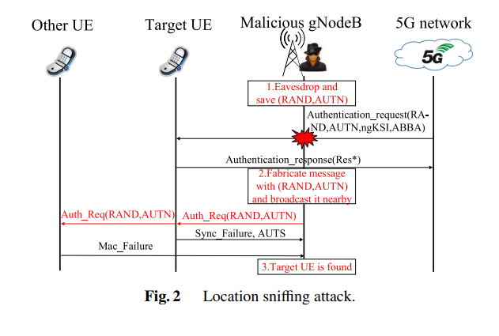
5G Attack Vectors
RA and CN don’t require authentication. Location sniffing attack
Place sniffing tool near target UE
Monitor for plaintext AuthReq msg
The message contains RAND and AUTN
Build an AuthReq message using that RAND and AUTN.
Broadcast fake message.
MAC check fails if not target UE
Victim UE passes MAC, fails SEQ
If all messages fail MAC verification, the UE is not nearby. If one SEQ failure, it is nearby.
https://www.jstage.jst.go.jp/article/transinf/E103.D/8/E103.D_2019FOL0001/_pdf
Notes:
Nokia’s head of Product Management Security, Patrick Rhude said that because of the types of devices connected, 5G networks have 200 times more attack vectors than 4G
RA and CN don’t require authentication. Fingerprinting
Location sniffing attack. The auth responses in AKA protocol are tx in plaintext ota. This can be used by an attacker to determine the target subscriber’s presence in a specific cell.
This is done by the attacker placing sniffing tool near the target UE, monitoring for the plaintext auth req msg of target ota.The msg contains RAND and AUTN.
Then an attacker builds an auth req msg using that RAND and AUTN and broadcasts the fabricated auth req msg anywhere in the target subscribers area!
If a MAC check fails the attacker will be sent a message indicating a MAC check failure. This occurs on all other UE besides the victim UE. The victim UE will actually pass MAC verification, but it’ll fail a different check for a sequence check. Therefore, the attacker can know if the target UE is nearby. If all messages fail MAC verification, the UE is not nearby. If there is one SEQ failure, it is nearby.

Slide 45
5G Attack Vectors
Attach Req Injection
Battery Draining
NB-IOT and LTE-M devices in particular can be drained like 5x faster than expected
AKA Attack
Sending malformed packets can trigger crashes in 5g cores. Yes, still.
Network Slicing Vuln
Deloitte gave a talk at RSA about this.
Navigate up a network slice looking for other vulnerable devices.
Multi-Access Edge Computing (MEC)
HTTP/2 Attacks
Stream Reuse
Closed Stream
End-to-end China Unicom
Notes:
Attach Req Injection.
Attach Req is always sent unencrypted by the UE to the network. It’s not Integrity Protected generally in 5g. However, reg process isn’t stopped if integrity verification fails at the MME. So the attach req can be modified along the way.
Battery Draining
NB-IOT and LTE-M devices in particular can be drained like 5x faster than expected
Example is relying on the “Power Saving Mode” messages from the network. If an attacker turns off that functionality in an Attach Request message, then the UE won’t receive the POWER SAVING MODE ON msg from the network.
So then the battery is more heavily used for signal measurements and other modem activities.
AKA Attack - key procedure still weak
Sending malformed packets can trigger crashes in 5g cores. Yes, Still.
Network Slicing Vuln -
Deloitte gave a talk at RSA about this.
This is pretty much still better than a lot of predecessors but once in the network slice specifically an attacker can navigate up a network slice looking for other vulnerable devices. Pretty much just that anything on the wild internet can be more easily exploited. This isn’t so much a core network attack as an internet based attack for entry to the network slice. Not as interesting from the telecom perspective
MEC (multi-access edge computing) moves some of the CN functions closer to the UE at the network edge. While this reduces latency, it means untrusted 5g elements can be introduced into the core network functionalities.
Eg. It’s possible that a fw vuln in the MEC allows a persistent foothold. From there, an attacker could not only use this functionality to deny access, but also to gain UE and sensor data. From this entrance vector the attacker can gain full access to the RAN and clone a UE.
HTTP/2 Stream Reuse Attack
Attacker can masquerade as Network Function and send multiple TCP streams over one connection. That would lead to stream ID exhaustion for vaLid NFs.
HTTP/2 Closed Stream leading to Server Crash
Malicious stream close identifier can be sent in the same connection causing a server crash??
end-to-end China Telecom Vuln
issues in Paging, attach procedure and service request. (Those either need TMSI or GUTI) to AMF
MME attach accept/reject, MME attach compete, MME Service Request, MME extended service request
confirmed by CNVD and CNNVD but no written evidence that I could find…
Vulnerable to DoS that prevents idle devices (and devices temporarily disconnected due to errors) from re-connecting to the network.
Higher recommend reading up on PIERCER and TORPEDO if you’re interested.

Slide 46

Review
2G: Digital Technology! Voice and Data. Circuit Switched. User, BSS, MSC, GMSC.
GPRS: Both Circuit and Packet Switched! Added the SGSN and GGSN.
3G: UMTS NodeB, RNC, kept SGSN and GGSN.
LTE: Evolved packet core! eNodeB, Mobility Management, Signal Gateway and PDN Gateway.
4G: VoLTE, IPv6, IMS. Kept devices same.
5G: Virtualization. Network slicing. gNodeB. Functionality generally split into “functions” instead of devices.
Notes:
2G: Digital Technology! Voice and Data. Circuit Switched. User, BSS, MSC, GMSC.
GPRS: Both Circuit and Packet Switched! Added the SGSN and GGSN.
3G: UMTS NodeB, RNC, kept SGSN and GGSN.
LTE: Evolved packet core! eNodeB, Mobility Management, Signal Gateway and PDN Gateway.
4G: VoLTE, IPv6, IMS. Kept devices same.
5G: Virtualization. Network slicing. gNodeB. Functionality generally split into “functions” instead of devices.

Slide 47
References
Most used image came from https://en.wikipedia.org/wiki/Cellular_network
Device images came from vendor websites
The Critical Hole at the Heart of Our Cell Phone Networks, Zetter https://www.wired.com/2016/04/the-critical-hole-at-the-heart-of-cell-phone-infrastructure/
Taking up the Gauntlet - SS7 Attacks in Ukraine, Cathal Mc Daid, https://blog.adaptivemobile.com/russia-ukraine-telecom-monitoring
https://www.cnvd.org.cn/flaw/show/CNVD-2014-00546 Cisco ASR 5000 Series Devices GPRS Support Node Security Bypass Vulnerability
https://www.cisco.com/c/en/us/support/docs/csa/cisco-sa-cisco-pdng-dos-KmzwEy2Q.html Cisco Packet Data Network Gateway IPsec ICMP Denial of Service Vulnerability
https://sec.cloudapps.cisco.com/security/center/content/CiscoSecurityAdvisory/cisco-sa-20160621-asr Cisco ASR 5000 Series Packet Data Network Gateway Denial of Service Vulnerability
LTEInspector: A Systematic Approach for Adversarial Testing of 4G LTE, Syed Rafiul Hussain, Omar Chowdhury, Shagufta Mehnaz, Elisa Bertino
Nokia warns 5G security ‘breaches are the rule, not the exception’ , Kapko, https://www.cybersecuritydive.com/news/5g-security-breaches/636693/
5G Network Attacks Projects, https://networksimulationtools.com/5g-network-attacks-projects
P1 security Archives, https://www.p1sec.com/corp/category/p1-security/
A Vulnerability in 5G Authentication Protocols and Its Countermeasure (2020). Xinxin HU, Caixia LIU, Shuxin LIU, Jinsong LI, and Xiaotao CHENGHU. IEICE Transactions on Information and Systems. E103.D. 1806-1809. 10.1587/transinf.2019FOL0001.
Privacy Attacks to the 4G and 5G Cellular Paging Protocols Using Side Channel Information. Syed Rafiul Hussain, Mitziu Echeverria, Omar Chowdhury, Ninghui Li and Elisa Bertino. https://homepage.divms.uiowa.edu/~comarhaider/publications/LTE-torpedo-NDSS19.pdf

Slide 48
References
On the Detection of Signaling DoS Attacks on 3G WiMax Wireless Networks. Patrick P.C. Lee, Tian Bu , Thomas Woo https://citeseerx.ist.psu.edu/document?repid=rep1&type=pdf&doi=cb5197dfceb76fe6ac37909c6ef935285f9e0cc7
Statement of Vulnerabilities in ZTE MF910 and MF65+ Products. ZTE. 2019. https://support.zte.com.cn/support/news/LoopholeInfoDetail.aspx?newsId=1010203
ZTE MF910 – An end of life router, running lots of vivacious hidden code. Richter, Pentest Partners. https://www.pentestpartners.com/security-blog/zte-mf910-an-end-of-life-router-running-lots-of-vivacious-hidden-code
LTE Pwnage: Hacking HLR/HSS and MME Core Network Elements P1 Security. Presented at HITBSecConf2013. Amsterdam. https://conference.hitb.org/hitbsecconf2013ams/materials/D1T2%20-%20Philippe%20Langlois%20-%20Hacking%20HLR%20HSS%20and%20MME%20Core%20Network%20Elements.pdf
Privacy Attacks to the 4G and 5G Cellular Paging Protocols Using Side Channel Information. Syed Rafiul Hussain, Mitziu Echeverria, Omar Chowdhury, Ninghui L,, Elisa Bertino.
New 4G LTE Network Attacks Let Hackers Spy, Track, Spoof and Spam. Swati Khandelwal. The Hacker News, Mar 05, 2018. https://thehackernews.com/2018/03/4g-lte-network-hacking.html
GUTI Reallocation Demystified: Cellular Location Tracking with Changing Temporary Identifier. Byeongdo Hong, Sangwook Bae, Yongdae Kim. Presented at the Network and Distributed System Security Symposium.
https://syssec.kaist.ac.kr/pub/2018/hong_ndss_2018.pdf
A first look on the effects and mitigation of VoIP SPIT flooding in 4G mobile networks. Bou-Harb, Elias & Debbabi, Mourad & Assi, Chadi. (2012). 982-987. 10.1109/ICC.2012.6364233.
Cheating VoIP Security by Flooding the SIP. Irfan Shakeel. Jan 20, 2016. https://resources.infosecinstitute.com/topics/hacking/cheating-voip-security-by-flooding-the-sip/

Slide 49
More References!
New Vulnerabilities in 5G Networks. Altaf Shaik* , Ravishankar Borgaonkar. Presented at Black Hat Briefings. https://i.blackhat.com/USA-19/Wednesday/us-19-Shaik-New-Vulnerabilities-In-5G-Networks-wp.pdf
Cisco PGW 2200软体交换机多个安全漏洞. May 2010. CNVD -2010-0844. https://www.cnvd.org.cn/flaw/show/CNVD-2010-0844
LTE核心网存在拒绝服务漏洞. Jan 2021. CNVD-2020-71678. https://www.cnvd.org.cn/flaw/show/CNVD-2020-71678
Cisco Gateway GPRS Support Node TCP Invalid Packet Vulnerability. Cisco. CVE-2015-4201. https://sec.cloudapps.cisco.com/security/center/content/CiscoSecurityAdvisory/Cisco-SA-20150619-CVE-2015-4201
https://www.mpirical.com/ for 5G trainings
Signalling Security Analysis: Is HTTP/2 Secure in 5G Core Network? Xinxin Hu, Caixia Liu, Shuxin Liu, Wei You, Yu Zhao; 2018 10th International Conference on Wireless Communications and Signal Processing. Hangzhou, China, 2018. doi: 10.1109/WCSP.2018.8555612.
Bookworm Game: Automatic Discovery of LTE Vulnerabilities Through Documentation Analysis; Yi Chen, Yepeng Yao, XiaoFeng Wang, Dandan Xu, Chang Yeue , Xiaozhong Lui, Kai Chen, Haixu Tang, Bauxu Liu. 2021 IEEE Symposium on Security and Privacy IEEE publication
ESF Potential Threats to 5G Network Slicing, NSA, CISA. https://www.cisa.gov/news-events/alerts/2023/07/17/nsa-cisa-release-guidance-security-considerations-5g-netw
New Vulnerabilities in 5G Networks-Blackhat Briefings Altaf Shaik* , Ravishankar Borgaonkar. https://i.blackhat.com/USA-19/Wednesday/us-19-Shaik-New-Vulnerabilities-In-5G-Networks-wp.pdfork-slicing
Statement of Vulnerabilities in ZTE MF910 and MF65+ Products. ZTE. 20 February 2019. https://support.zte.com.cn/support/news/LoopholeInfoDetail.aspx?newsId=1010203
Potential Threat Vectors to 5G Infrastructure - U.S. Department of Defense. May 2021. https://media.defense.gov/2021/May/10/2002637751/-1/-1/1/POTENTIAL%20THREAT%20VECTORS%20TO%205G%20INFRASTRUCTURE.PDF

Slide 50
Questions?

Slide 51

Thank you!!!
Bedlam
My Parents
My coworkers (former and current) who gave feedback and taught me this stuff
My Aesthetic Support Team
Outfit Selection Committee
Besties and sister

